Slide 1
INDUSTRIAL POWER CONTROL BY INTEGRAL CYCLE SWITCHING WITHOUT GENERATING HARMONICS
Final Project Presentation
Submitted to:
Asikur Rahman Jowel
Lecturer, EEE, BUET
&
Azazul Islam
Adjunct Lecturer, EEE, BUET
Group-08
Group Members:
1906135 - Md. Hasan Newaz
1906153- Md. Asif Kabir
1906154- Tamim Hasan Bhuiyan
1906155- Shipon Hossain

Slide 2
Objectives
2
Efficient Power Control
Harmonics Mitigation
Enhanced Energy Savings
Improved Power Quality
Minimal EMI/RFI Interference
Real-time Control
Safety and Reliability

Slide 3
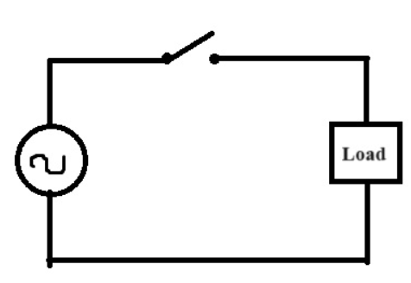
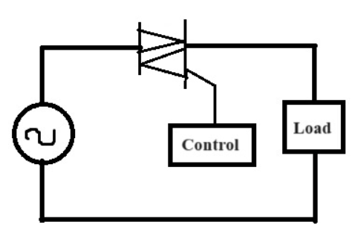
Working Principle
5
AC Signal
Load
Pulsating DC
TRIAC
Zero Crossing Detector
Opto-Coupler
Microcontroller
vs

Slide 4
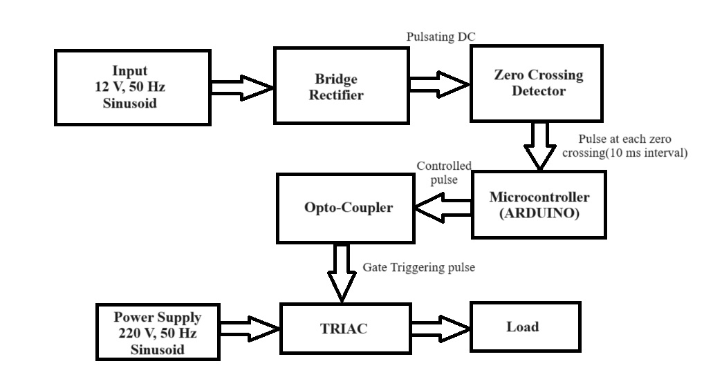
Block Diagram
3

Slide 5
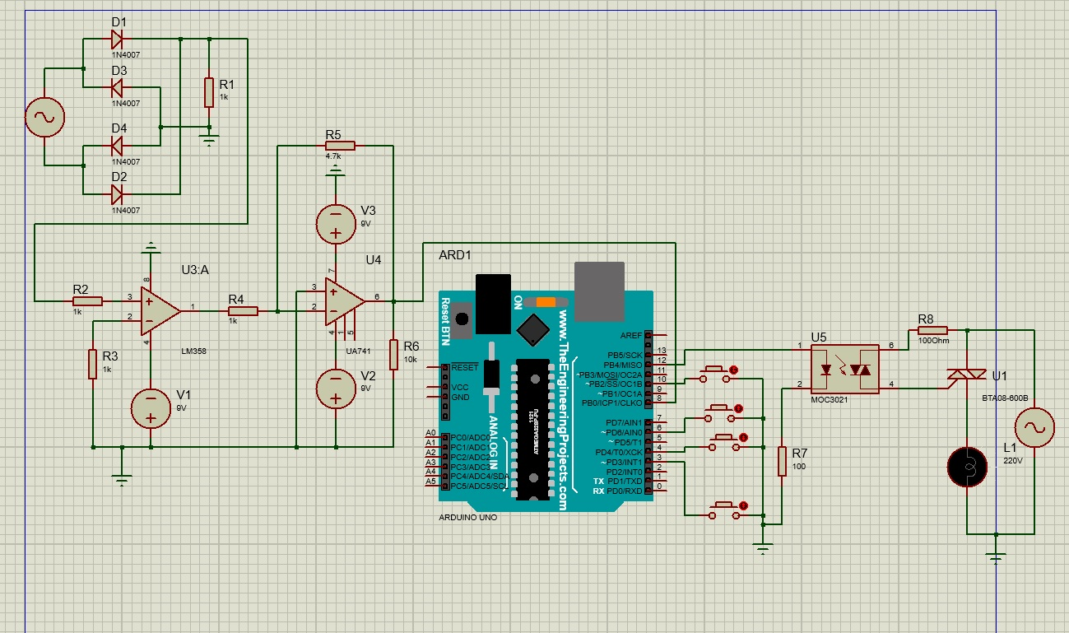
Circuit Diagram
3

Slide 6
Work Flow
4
Project Planning and Research
Hardware Implementation
System Design
Software Development
Harmonics Analysis and Mitigation:
Testing and Validation
Control Algorithm Development
Optimization and Fine-Tuning

Slide 7
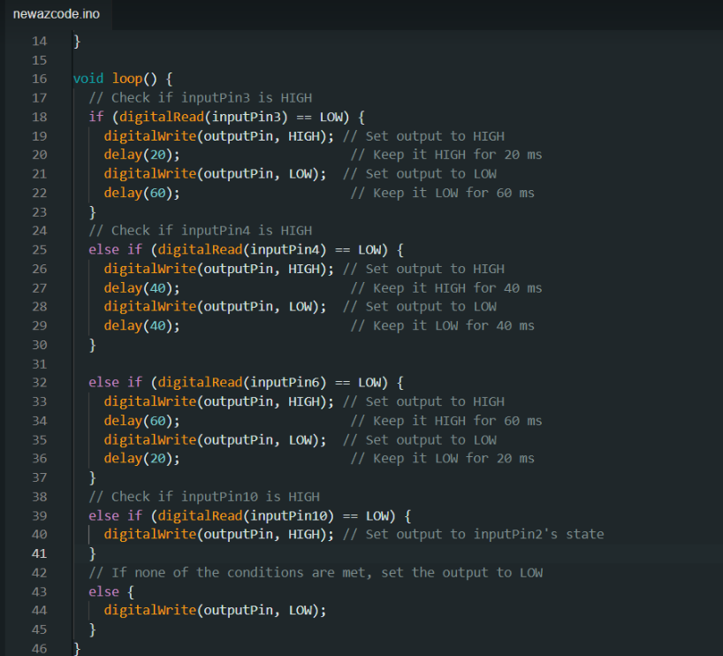
Algorithm

Slide 8

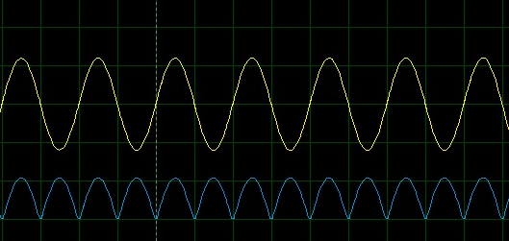
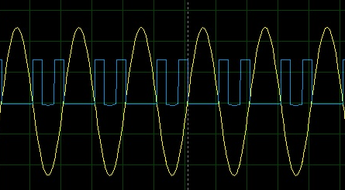
Step by Step Output
Pulsating DC Output From Bridge Rectifier
Output From Zero Crossing Detector

Slide 9
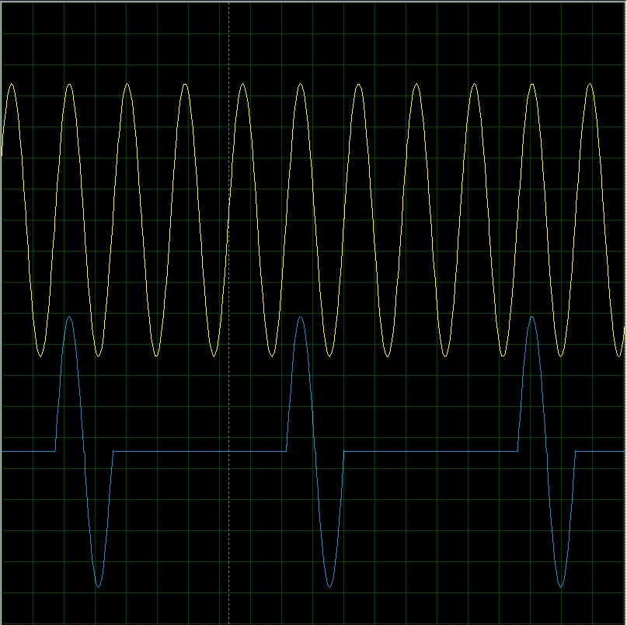
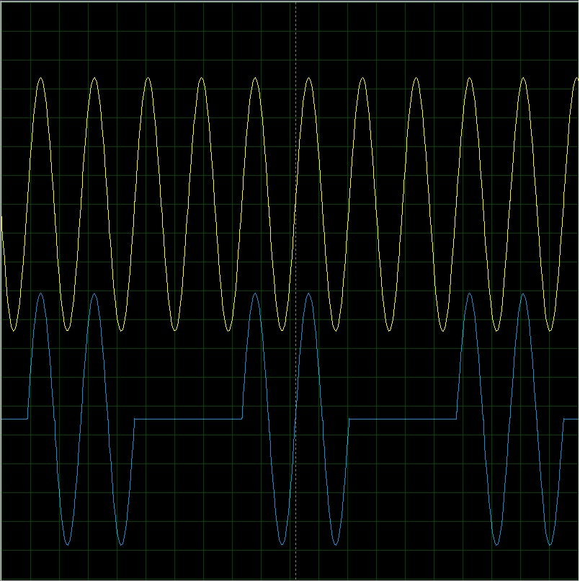
Step by Step Output
Fig: 1 cycle on 3 cycle off
Fig: 2 cycle on 2 cycle off

Slide 10
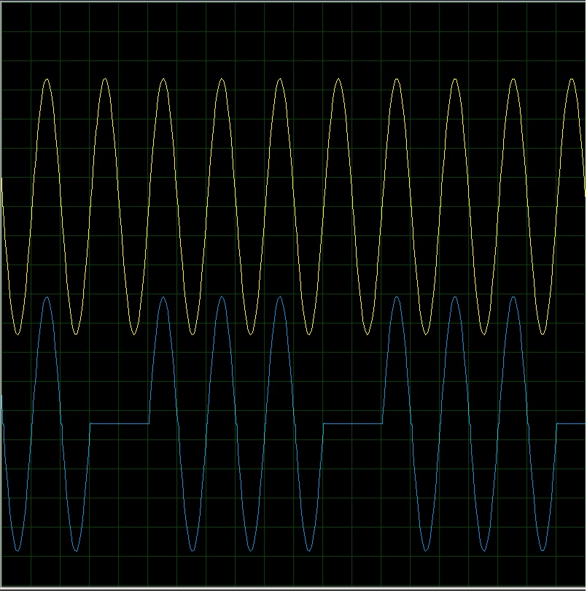
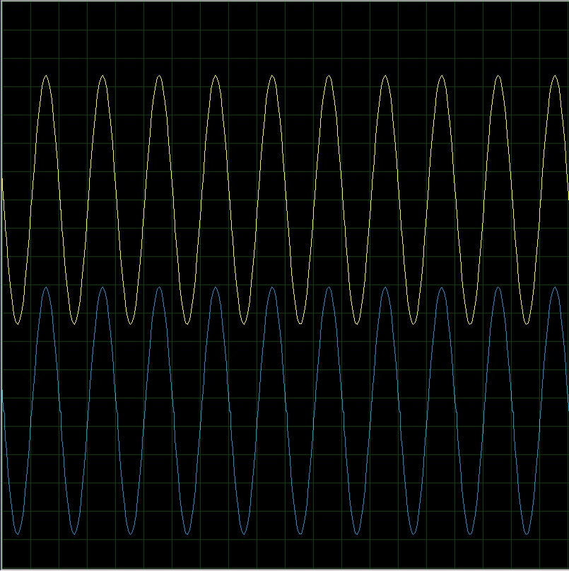
Step by Step Output
Fig: 3 cycle on 1 cycle off
Fig: All cycle on

Slide 11
Problems We Faced
We tried to use 8015 series Microcontroller, but we failed to upload code here.
We used a circuit to make a zero crossing detector but it didn’t work.
Because of using high voltage some of our component burnt.
Output voltage from our MC(Arduino) was very low for which we need some change in the circuit.

Slide 12
Problems Overcoming Process
We shifted to Arduino Uno (MC) to get the gate pulse.
We have designed a new circuit for zero-crossing detector.
We will work with low voltage for safety
We have changed the gain value to get proper output.

Slide 13
Cost Analysis
Components | Quantities | Price
Diodes (1N4007) | 4 pieces | 16 Tk.
Resistors (1kΩ) | 5 pieces | 5 Tk.
Resistors (100 Ω) | 2 pieces | 2 Tk.
Resistors (10 kΩ) | 1 piece | 1 Tk.
Op-Amp (LM358) | 1 piece | 10 Tk.
Op-Amp (uA741) | 1 piece | 15 Tk.
ARDUINO UNO | 1 piece | 700 Tk.
Push Buttons | 4 pieces | 20 Tk.
Opto-Coupler (MOC3021) | 1 piece | 40 Tk.
TRIAC (BT136) | 1 piece | 24 Tk.
Lamp | 1 piece | 60 Tk.
Breadboard | 2 pieces | 130 Tk.
Jumpper Connectors |  | 50 Tk.
Total |  | 1000 Tk

Slide 14
Applications
6
This method is used in industry for controlling power.
This method is also used in house such as fan, motor, water pumping etc.
It is used to controlling the power in linear loads.
Where we have to control the speed, intensity and power then this method is applicable.

Slide 15
Thank You

